Slide 1

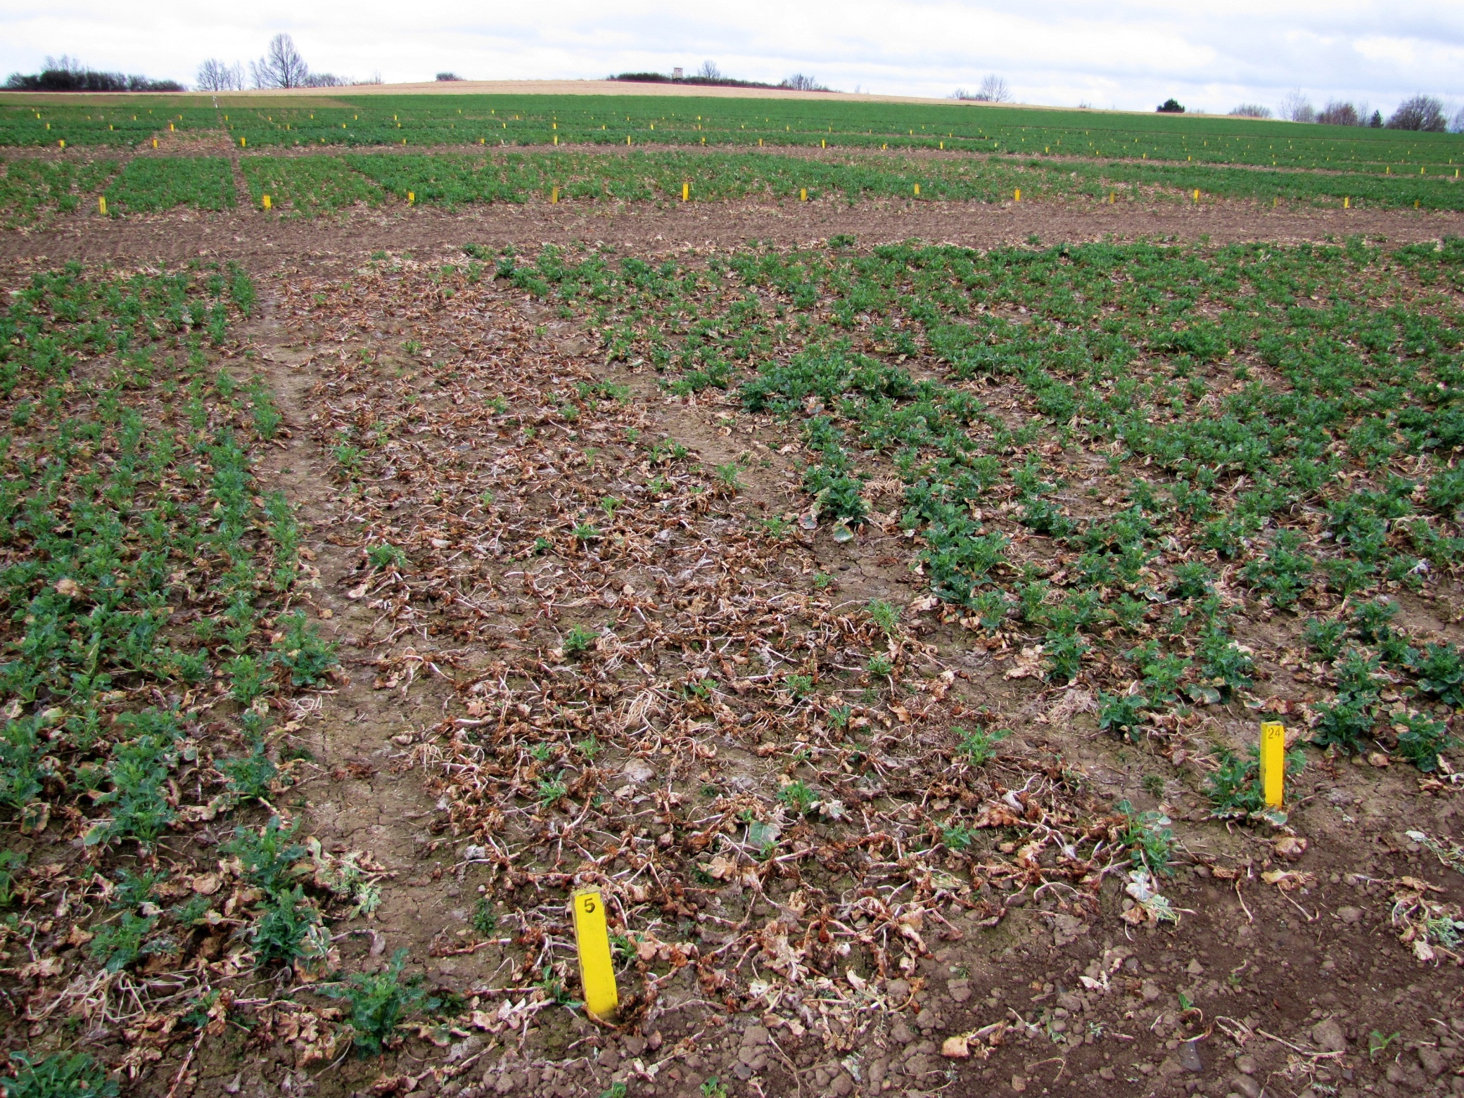
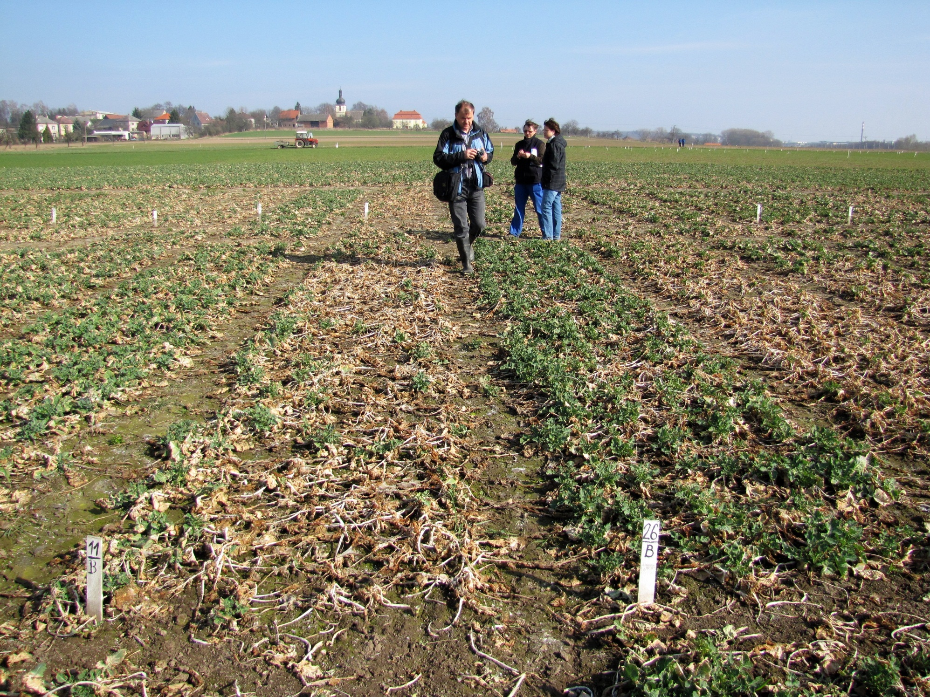
Comparison of the WOSR winter hardiness in the years 2010-2012
PETR ZEHNÁLEK¹, PETR BARANYK²
¹ Central Institute for Supervising and Testing in Agriculture, 569 01 Hradec nad Svitavou,
Czech Republic, petr.zehnalek@ukzuz.cz
² Czech University of Agriculture, 165 21 Prague 6 – Suchdol,
Czech Republic, baranyk@af.czu.cz
Winter hardiness was assessed in experiments founded for a Czech winter rape recommended list. There were included 15 hybrids, 20 lines and 1 semi dwarf hybrid varieties at 17 locations in 2009/10, 13 hybrids, 12 lines and 1 semi dwarf hybrid varieties at 15 locations in 2010/11, and 13 hybrids, 13 lines and 1 semi dwarf hybrid varieties at 18 locations in 2011/12.
These small plot trials (1 plot = 10 m²) were 3x replicated. Winter hardiness was expressed as a percentage of plants overwintered, which is calculated from the evaluation of porosity in % in autumn and in the spring.
13 sites were included in the evaluation in 2011/12. Varieties with the best hardiness were Ladoga, Cortes, NK Morse and Arot. The most sensitive varieties were SY Cassidy, Lohana and ES Alegria.
Individual years were compared with each other by comparing the sequence of varieties due to partly differing lists of varieties in these years.
Table 1. Level of crop management
 | Level of crop management
Seed rate | lines 70 seeds/m², hybrids 50 seeds/m²
N fertilization | 160 kg/ha after cereal forecrop 90 kg/ha after clover or cereal and legume mixture
S fertilization | 40 kg/ha after cereal forecrop 25 kg/ha after clover or cereal and legume mixture
B fertilization | None
Growth regulator | None
Fungicide spraying | None
Comparison is available in the varieties tested in at least two years if they have been tested in the season 2011/12.
High level of winter hardiness proved repeatedly varieties Ladoga, Xenon, DK Exquisite, DK Secure and PR46W26. Based on the multi-annual comparison can be Chagall, Dobrava, Totem and ES Alegria evaluated as the most susceptible varieties to winter kill.
Winter kill in seasons 2009/10 and 2010/11 was smaller, so only these locations were included in the evaluation, where distinction between least and most defective variety was at least 5%. Damage in the season 2011/12 was significantly larger, so they were included only sites with at least 10% of the difference in the evaluation.
11 sites were included in the evaluation in 2009/10. Varieties with the best hardiness were DK Secure, PR46W26, SW 05025 A (Da Vinci), Sherlock and Hornet. The most sensitive varieties were Goya and DK Cabernet.
10 sites were included in the evaluation in 2010/11. Varieties with the best hardiness were DK Secure, Xenon, Ladoga and Primus. The most sensitive varieties were Totem and Goya.
After evaluating of resistance to winter kill in the last three years, it is evident that despite the relatively small amount of damage (see years 2010 and 2011), when localities with relatively little difference between varieties (min. 5%) were included in the average, also small plot trials may offer reliable results of the resistance of the varieties, especially regarding to varieties
with high resistance or susceptibility to winter kill.
Table 2. Results of the WOSR varieties´ winter hardiness after winter season 2011/12 in the Czech Republic
Variety | Type of variety | Localities |  |  |  |  |  |  |  |  |  |  |  |  |  |  |  |  |  | Mean of variety | Sequence of variety 2009/10 | Sequence of variety 2010/11 | Sequence of variety 2011/12
 |  | Pusté Jakartice* | Libějovice* | Vysoká* | Humpolec* | Staňkov* | Trutnov | Slapy u Tábora | Chlumec n.C. | Opava | Hradec n.S. | Domanínek | Jaroměřice n.R. | Lípa | Věrovany | Krásné Údolí | Horažďovice | Hněvčeves | Čáslav
Ladoga | L | 100 | 100 | 99 | 99 | 93 | 98 | 95 | 95 | 100 | 97 | 92 | 97 | 95 | 93 | 100 | 82 | 90 | 50 | 91 | 6 | 3 | 1
Cortes | L | 100 | 100 | 100 | 99 | 97 | 98 | 94 | 96 | 100 | 95 | 89 | 92 | 96 | 86 | 100 | 90 | 77 | 63 | 91 | - | - | 2
NK Morse | L | 100 | 100 | 98 | 99 | 93 | 98 | 94 | 92 | 100 | 95 | 99 | 87 | 96 | 89 | 100 | 92 | 75 | 49 | 90 | 15 | 23 | 3
Arot | L | 100 | 99 | 99 | 99 | 93 | 100 | 96 | 97 | 92 | 96 | 100 | 92 | 94 | 87 | 97 | 85 | 76 | 53 | 90 | 14 | 17 | 4
Xenon | H | 100 | 100 | 100 | 99 | 94 | 98 | 96 | 85 | 96 | 95 | 95 | 95 | 98 | 89 | 90 | 83 | 77 | 66 | 89 | - | 2 | 5
DK Exquisite | H | 100 | 100 | 100 | 99 | 97 | 98 | 96 | 94 | 100 | 98 | 94 | 89 | 95 | 89 | 100 | 83 | 74 | 52 | 89 | 11 | 9 | 6
DK Secure | SD | 100 | 100 | 100 | 98 | 99 | 96 | 98 | 92 | 92 | 100 | 94 | 92 | 97 | 87 | 100 | 83 | 54 | 71 | 89 | 1 | 1 | 7
Sherpa | H | 100 | 100 | 100 | 99 | 96 | 98 | 94 | 94 | 100 | 90 | 96 | 88 | 96 | 88 | 88 | 87 | 75 | 56 | 88 | - | - | 8
Rohan | H | 100 | 100 | 99 | 99 | 94 | 98 | 95 | 96 | 96 | 95 | 94 | 88 | 95 | 88 | 97 | 84 | 74 | 43 | 88 | 16 | 4 | 9
NK Grandia | L | 100 | 99 | 100 | 98 | 94 | 90 | 96 | 95 | 97 | 84 | 95 | 90 | 90 | 87 | 90 | 92 | 93 | 34 | 87 | - | - | 10
PR46W26 | H | 100 | 100 | 100 | 99 | 97 | 98 | 94 | 96 | 100 | 99 | 94 | 90 | 91 | 87 | 87 | 89 | 57 | 44 | 87 | 2 | 11 | 11
Inspiration | H | 100 | 100 | 100 | 100 | 96 | 100 | 96 | 96 | 97 | 90 | 90 | 94 | 88 | 85 | 92 | 87 | 63 | 39 | 86 | - | - | 12
Sherlock | L | 100 | 100 | 100 | 97 | 94 | 98 | 95 | 93 | 97 | 89 | 89 | 96 | 93 | 88 | 94 | 79 | 57 | 41 | 85 | 4 | 16 | 13
Jumper | H | 100 | 100 | 100 | 99 | 97 | 100 | 95 | 93 | 100 | 86 | 90 | 90 | 89 | 94 | 77 | 82 | 70 | 38 | 85 | - | - | 14
Artoga | H | 100 | 100 | 100 | 99 | 94 | 100 | 96 | 93 | 93 | 90 | 78 | 92 | 89 | 85 | 83 | 88 | 70 | 41 | 84 | 23 | 7 | 15
NK Diamond | L | 100 | 100 | 100 | 96 | 95 | 98 | 95 | 89 | 100 | 88 | 85 | 90 | 92 | 87 | 87 | 88 | 47 | 35 | 83 | 10 | 14 | 16
Primus | H | 100 | 100 | 100 | 99 | 94 | 98 | 96 | 91 | 96 | 89 | 97 | 92 | 92 | 92 | 75 | 72 | 54 | 34 | 83 | 29 | 5 | 17
Rumba | H | 100 | 100 | 100 | 99 | 96 | 98 | 95 | 93 | 96 | 94 | 92 | 87 | 92 | 89 | 72 | 73 | 47 | 39 | 82 | - | - | 18
NK Speed | H | 100 | 100 | 100 | 99 | 96 | 93 | 96 | 94 | 92 | 89 | 86 | 83 | 93 | 90 | 84 | 75 | 54 | 34 | 82 | 30 | 8 | 19
Chagall | L | 100 | 100 | 100 | 99 | 91 | 100 | 95 | 89 | 96 | 88 | 90 | 87 | 93 | 83 | 88 | 77 | 44 | 30 | 81 | 26 | 24 | 20
Dobrava | H | 100 | 100 | 100 | 99 | 94 | 97 | 92 | 94 | 71 | 95 | 85 | 86 | 88 | 88 | 89 | 70 | 50 | 45 | 81 | 33 | 18 | 21
SW 05025 A (Da Vinci) | L | 100 | 100 | 100 | 99 | 95 | 93 | 96 | 91 | 76 | 82 | 89 | 92 | 86 | 85 | 84 | 87 | 50 | 34 | 80 | 3 | 19 | 22
Totem | L | 100 | 99 | 100 | 99 | 90 | 97 | 95 | 93 | 70 | 94 | 86 | 83 | 80 | 74 | 88 | 77 | 37 | 24 | 77 | 8 | 25 | 23
Buzz | L | 100 | 100 | 99 | 98 | 93 | 98 | 95 | 93 | 83 | 89 | 81 | 85 | 63 | 80 | 55 | 75 | 33 | 29 | 74 | - | - | 24
SY Cassidy | H | 100 | 100 | 100 | 98 | 97 | 97 | 95 | 85 | 86 | 89 | 83 | 89 | 84 | 97 | 49 | 62 | 27 | 11 | 73 | - | - | 25
Lohana | L | 100 | 100 | 99 | 100 | 93 | 97 | 77 | 98 | 83 | 72 | 76 | 92 | 67 | 84 | 68 | 54 | 40 | 35 | 72 | - | - | 26
ES Alegria | L | 100 | 100 | 100 | 100 | 93 | 95 | 95 | 88 | 74 | 91 | 94 | 83 | 59 | 81 | 73 | 40 | 27 | 18 | 71 | 24 | 20 | 27
MD 0.05** |  | - | - | - | - | - | - | - | - | - | - | - | - | - | - | - | - | - | - | 6 | - | - | -
Mean of locality |  | - | - | - | - | - | 97 | 94 | 93 | 92 | 91 | 90 | 90 | 89 | 87 | 85 | 79 | 59 | 41 | 84 | - | - | -
Correlation |  | - | - | - | - | - | 0,27 | 0,38 | 0,27 | 0,74 | 0,54 | 0,61 | 0,53 | 0,87 | 0,36 | 0,82 | 0,81 | 0,89 | 0,81 | - | - | - | -
*Trial site is not included in the mean of variety, because there were no significant differences in varieties´ winter hardiness

